Slide 1
Deep Learning / Machine Learning Seminar
- YOLO / GAN -

Slide 2
Index
YOLO
GAN
Conclusion (RL short review)

Slide 3
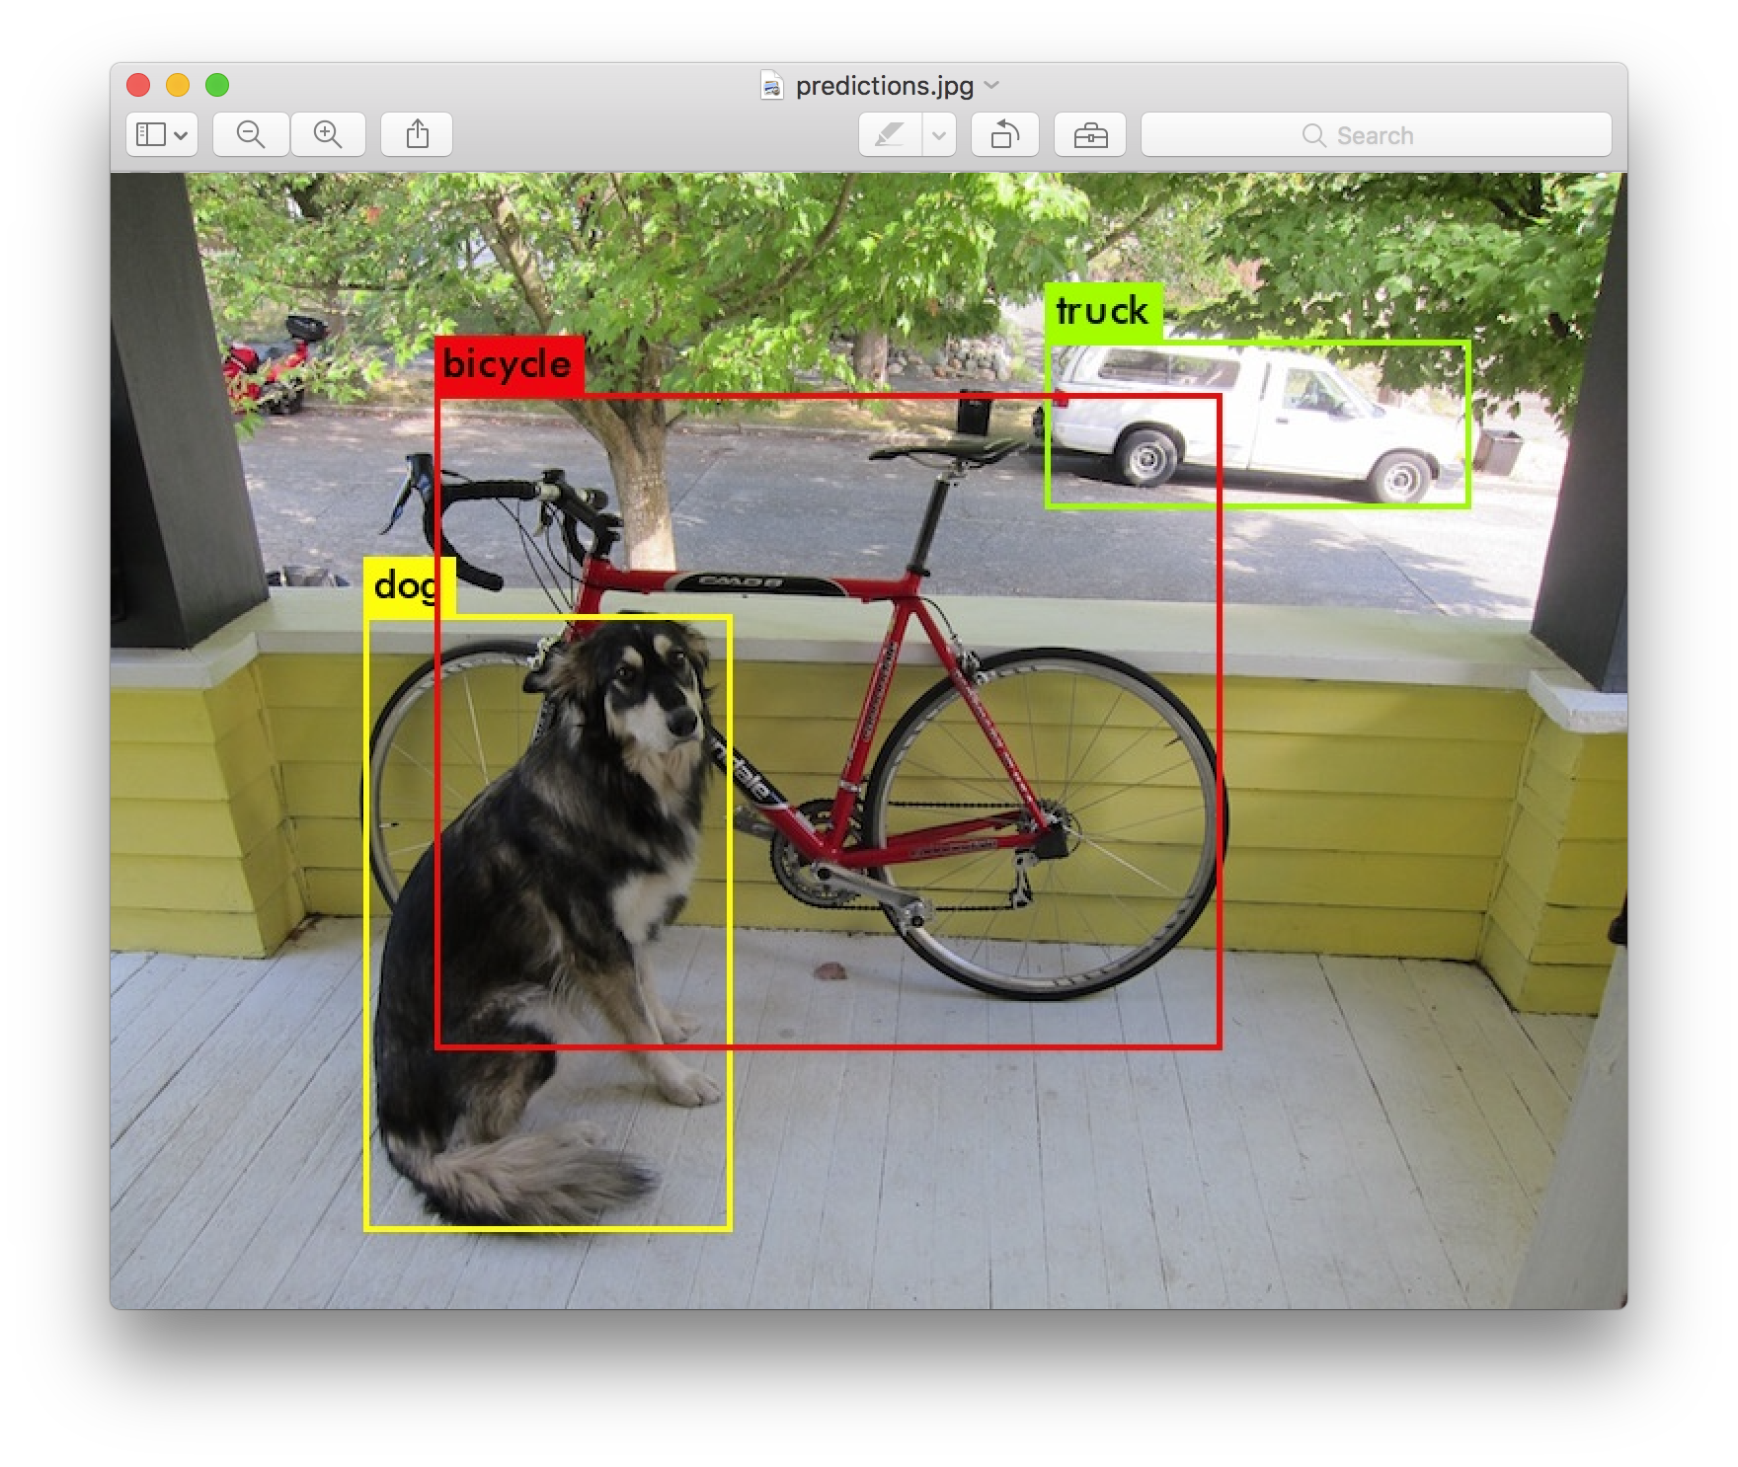
YOLO
What is YOLO?
You Only Live Once? [x]
You Only Look Once!
https://pjreddie.com/darknet/yolo/

Slide 4
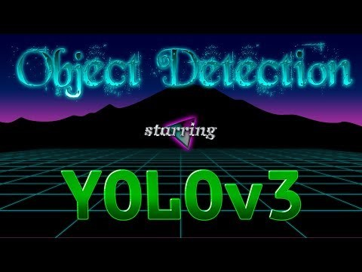
YOLO
https://youtu.be/MPU2HistivI

Slide 5
YOLO
How to Use?
Check out the darknet site…
Wide application! ex] image detection / real-time image detection…
Would be veeeeeery useful if you are doing autonomous driving proj.

Slide 6
GAN
What is GAN?
GAN stands for Generative Adversarial Networks
대부분의 여러분들이 개쩐다!라고 생각했던 딥-러닝은 GAN응용
Applications : image synthesis, image generator,

Slide 7
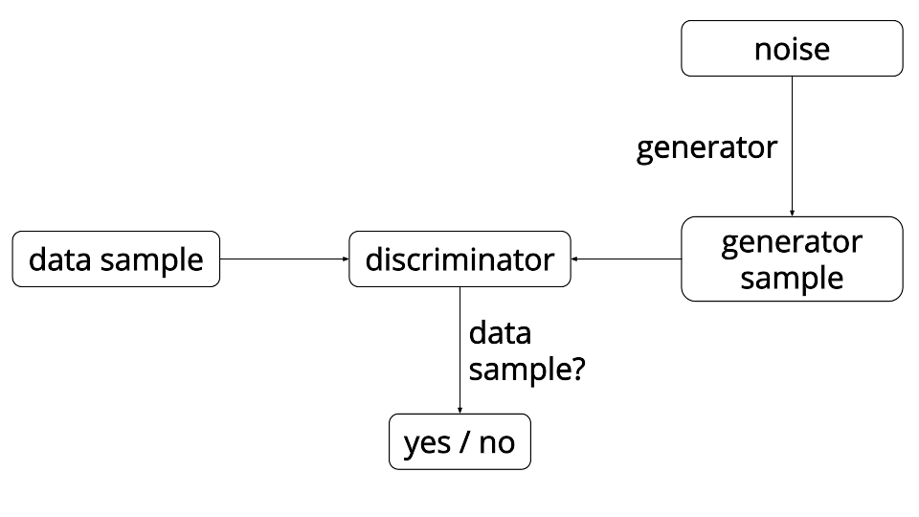
GAN

Slide 8
GAN
A discriminative model learns a function that maps the input data (x) to some desired output class label (y). In probabilistic terms, they directly learn the conditional distribution P(y|x).
A generative model tries to learn the joint probability of the input data and labels simultaneously, i.e. P(x,y). This can be converted to P(y|x) for classification via Bayes rule, but the generative ability could be used for something else as well, such as creating likely new (x, y) samples.

Slide 9
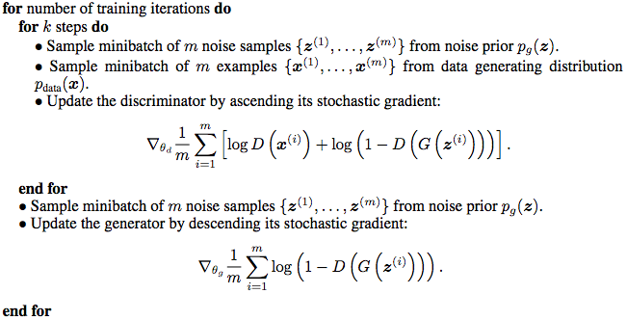
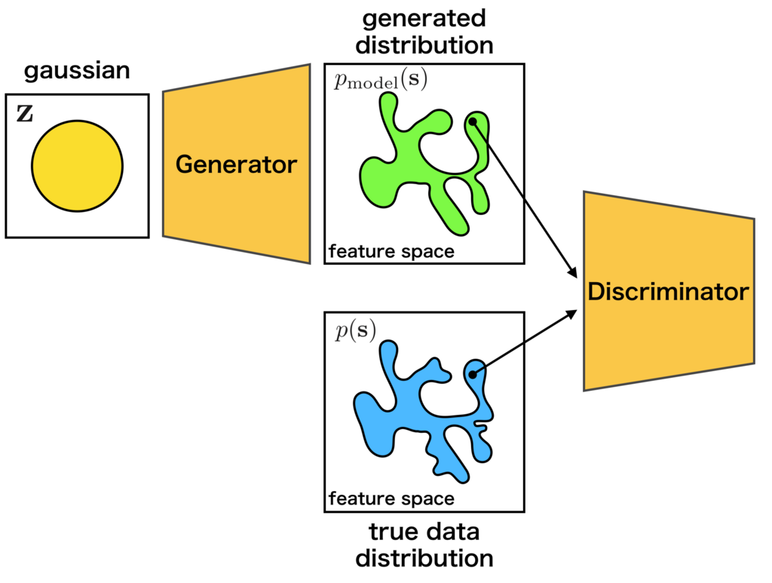
GAN

Slide 10
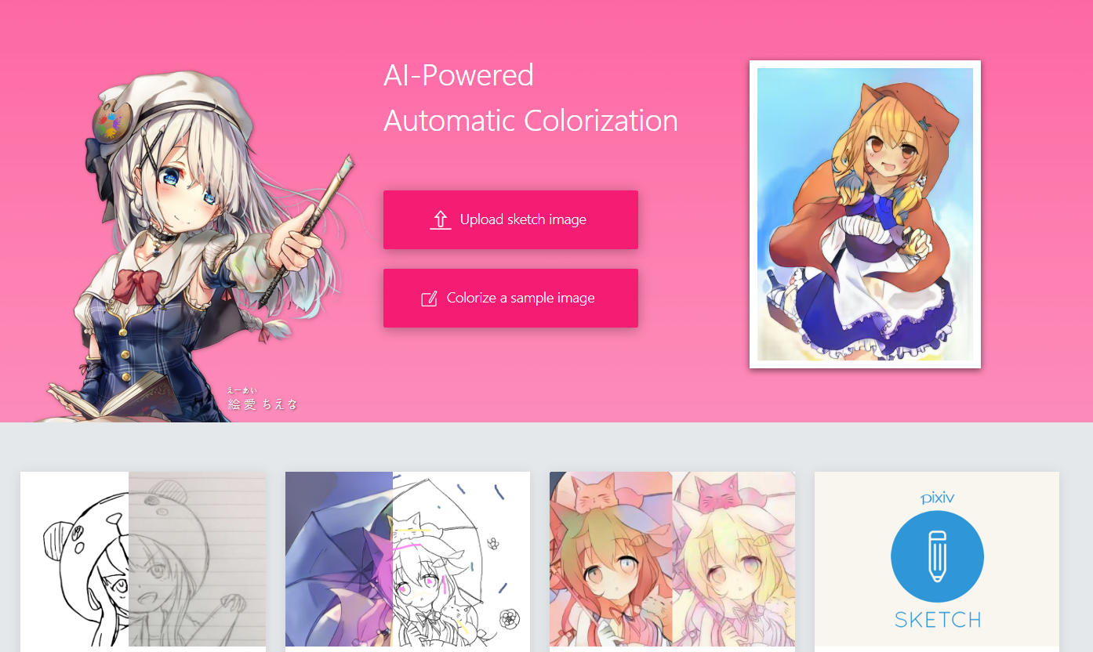
GAN
Applications
1] https://paintschainer.preferred.tech/index_en.html // auto-sketch

Slide 11
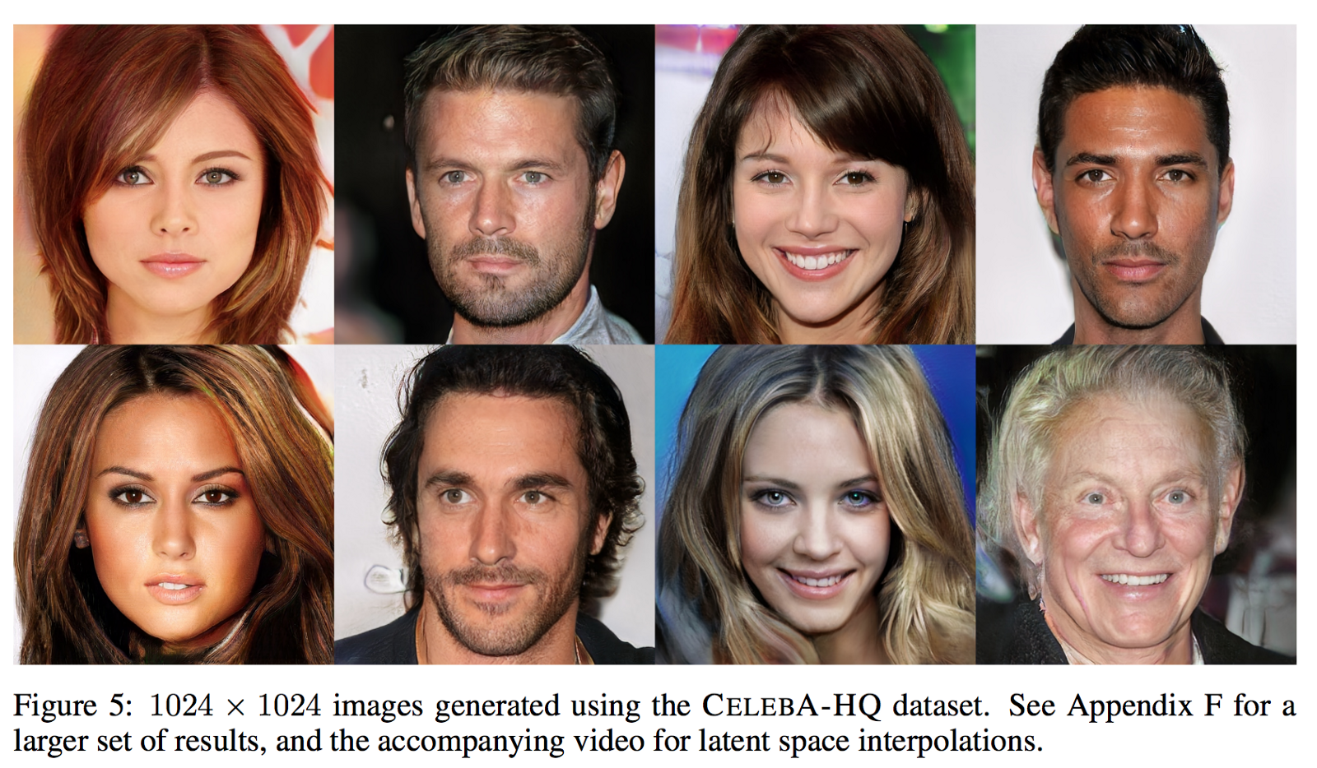
GAN
Applications
2] https://arxiv.org/pdf/1710.10196.pdf // progressive GAN (super resolution)

Slide 12
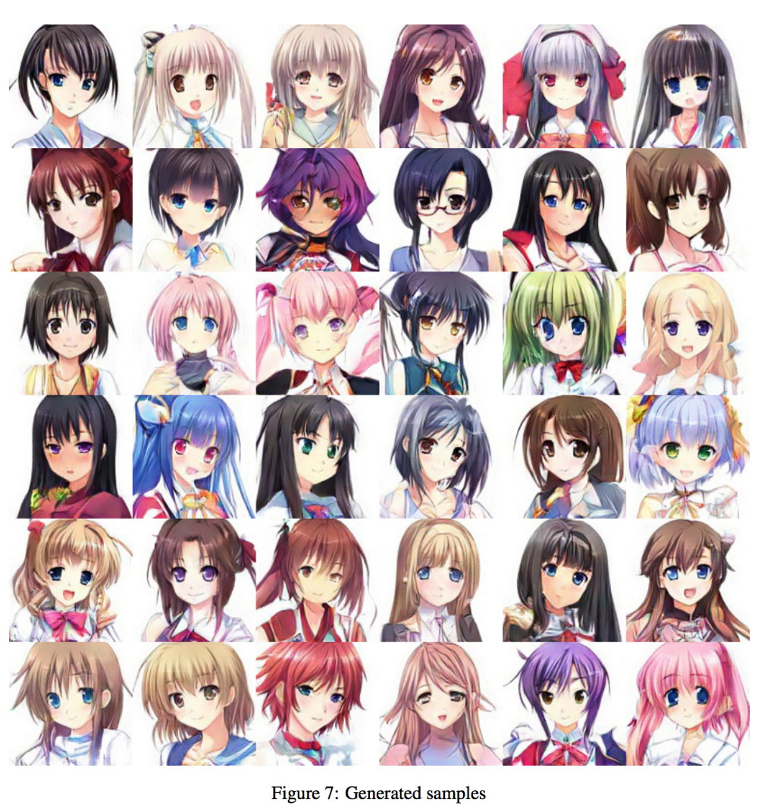
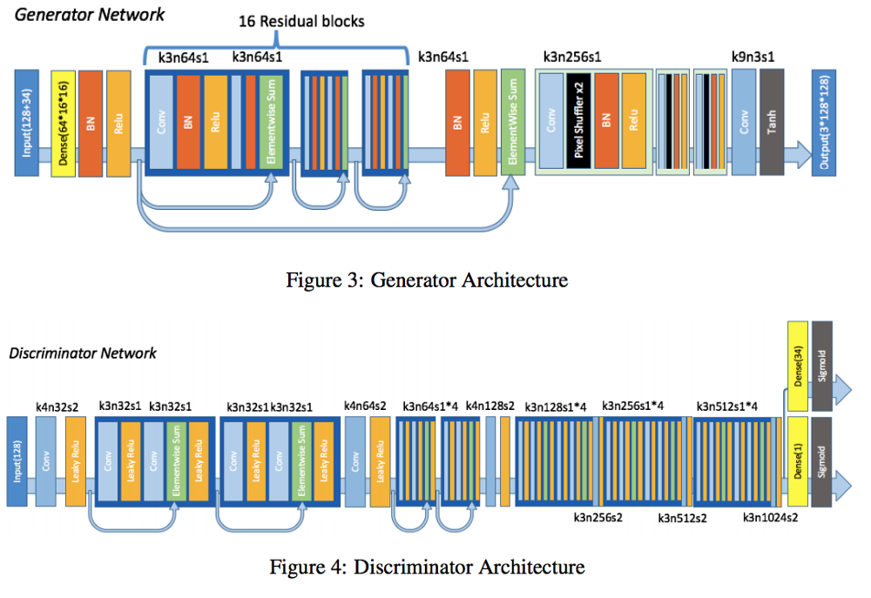
GAN
Applications
3] https://arxiv.org/pdf/1708.05509.pdf // auto-anime character generation

Slide 13
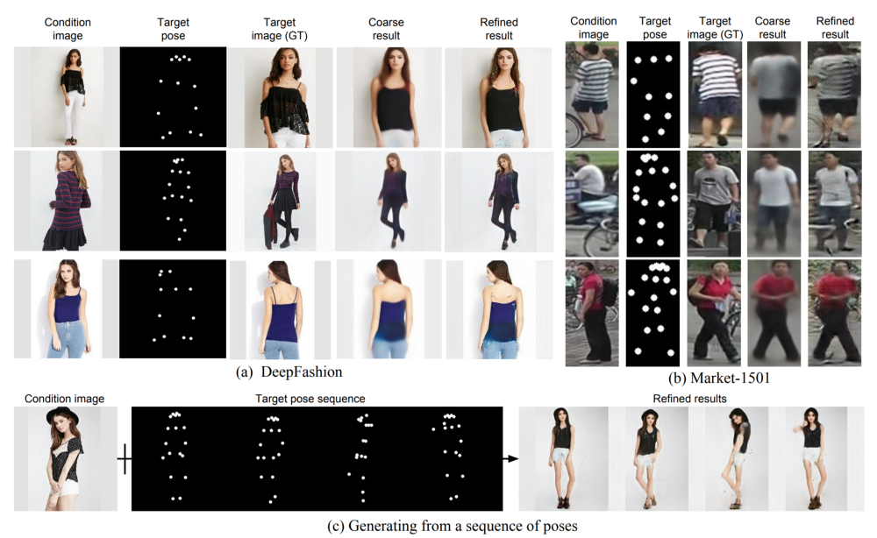
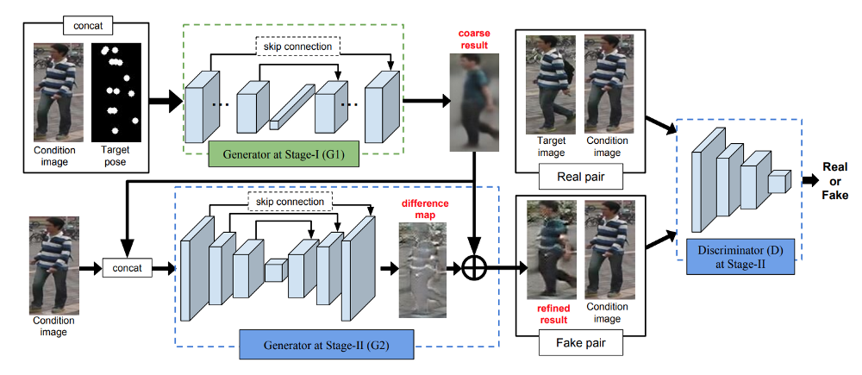
GAN
Applications
4] https://papers.nips.cc/paper/6644-pose-guided-person-image-generation.pdf // pose-guided person image generation

Slide 14
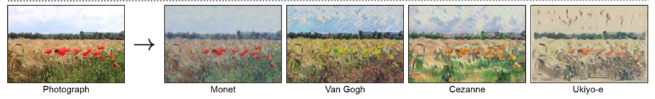
GAN
Applications
5] https://github.com/junyanz/CycleGAN // image - synthesis (cycleGAN)

Slide 15
GAN
Applications
6] https://tcwang0509.github.io/pix2pixHD/ // pix-pix HD (reverse of image segmentation)

Slide 16
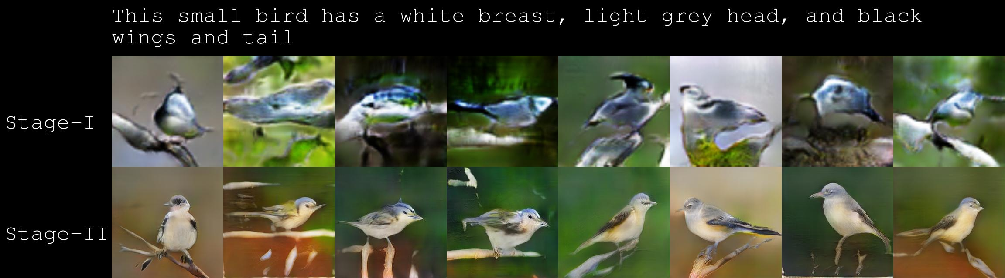
GAN
Applications
7] https://github.com/hanzhanggit/StackGAN // stack GAN (text->image)

Slide 17
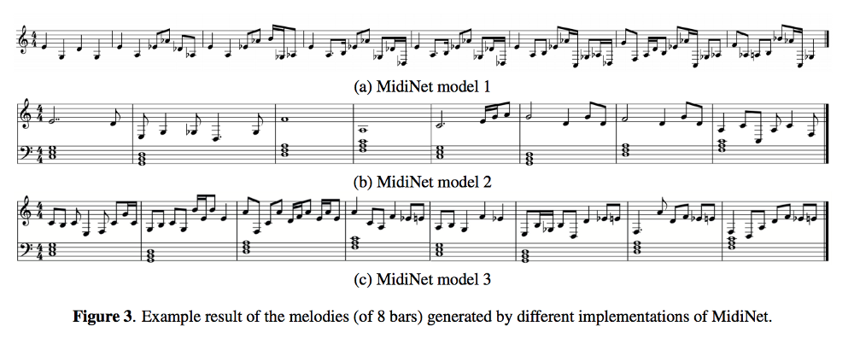
GAN
Applications
8] https://arxiv.org/pdf/1703.10847.pdf // midi GAN (music generator)

Slide 18
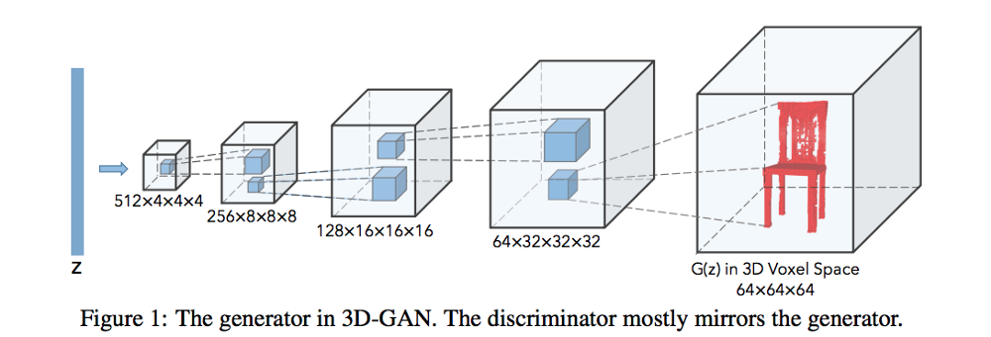
GAN
Applications
9] http://papers.nips.cc/paper/6096-learning-a-probabilistic-latent-space-of-object-shapes-via-3d-generative-adversarial-modeling.pdf // 3d-GAN

Slide 19
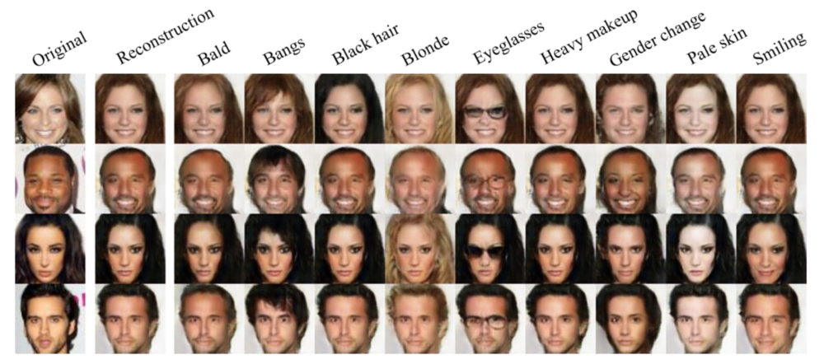
GAN
Applications
10] https://github.com/Guim3/IcGAN // Image Editing (IcGAN)

Slide 20
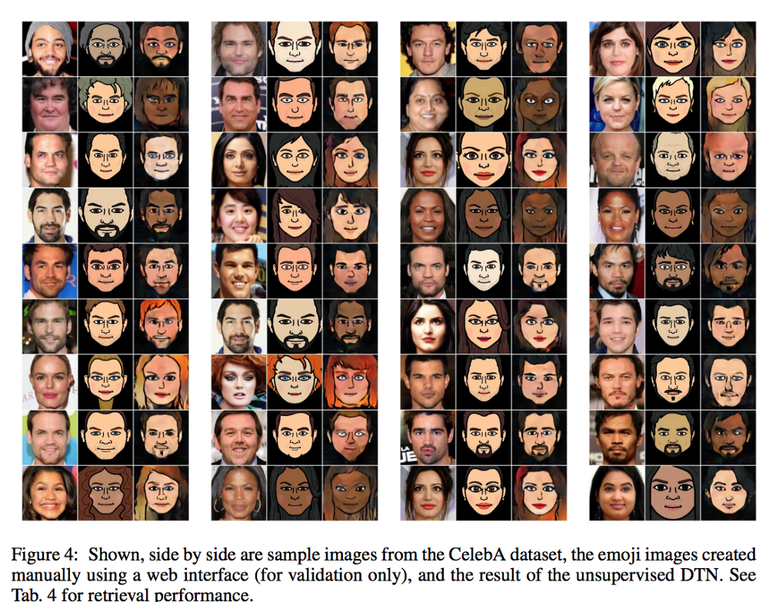
GAN
Applications
11] https://arxiv.org/pdf/1611.02200.pdf // emoji (charcter)
Ref : https://medium.com/@jonathan_hui/gan-some-cool-applications-of-gans-4c9ecca35900

Slide 21
GAN
Many GAN implementations are here!
https://github.com/wiseodd/generative-models
이거 갖고 응용 / 본인의 데이터셋에 갖다 써보시고
그 이외의 GAN 모델들은 논문을 읽고 구현해야함.

Slide 22
Conclusion of DL - Seminar
What we have learnt…
1] Python Basic (with codes)
2] Simple Linear / Logistic Regression (with codes)
3] SVM / KNN (with codes)
4] CNN (with codes)
5] RNN and LSTM (with codes)
6] YOLO (with materials only)
7] GAN (with codes)

Slide 23
Conclusion of DL - Seminar
Deep Learning is AWESOME!
“Almost” everything that you imagine can be implemented by DL
Beyond Deep Learning ?
Reinforcement Learning
RL ? = Unsupervised Learning
Super Mario AI : https://www.youtube.com/watch?v=qv6UVOQ0F44
GTA AI : https://youtu.be/VRsmPvu0xj0?t=887

Slide 24
Conclusion of DL - Seminar
Reinforcement Learning example
Q-Learning / DQN …
See Lectures on Youtube :
https://youtu.be/dZ4vw6v3LcA // (킹-한국어 강의임)
https://youtu.be/xoxz-OmcL1Q // (waterloo 대학 강의)

Slide 25
Conclusion of DL - Seminar
Thanks for your Attention!
딥러닝으로 시그마에서 다양한 프로젝트를 진행하시고, 공부하신 뒤에
후배들에게 딥러닝 세미나를 진행해주시길 부탁드립니다! ㅎㅎㅎㅎ
TRUST ME, I’M SIGMA

